Slide 1
Massachusetts Leadership in Offshore Wind
May 23, 2018
Stephen Pike, CEO

Slide 2
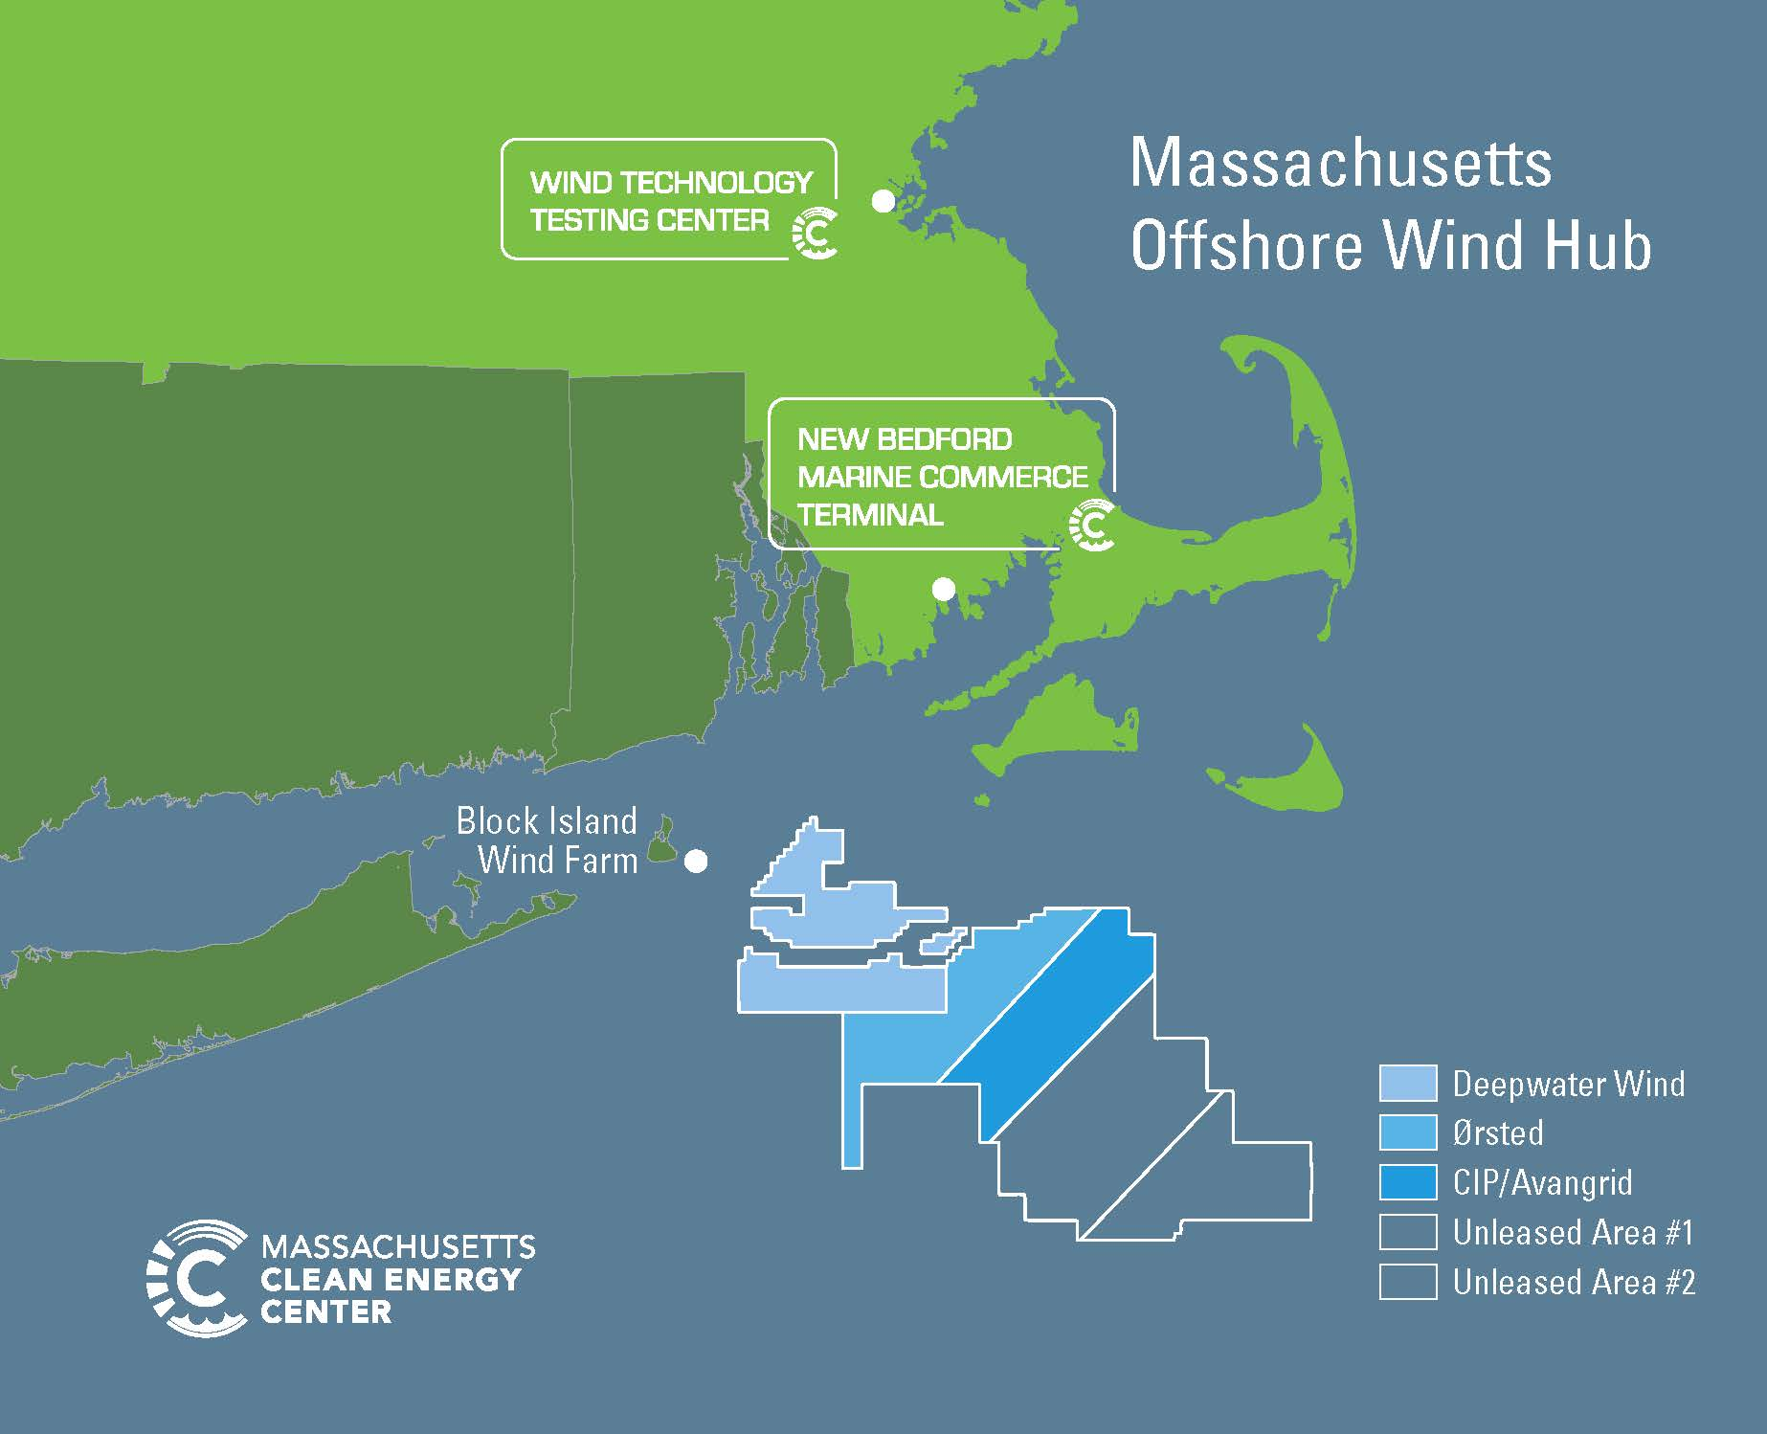
New England Offshore Wind Lease Areas

Slide 3
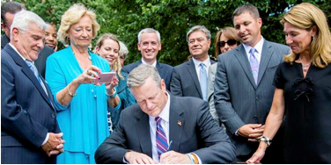
Pathway to Market: MA Offshore Wind Legislation
Mass Legislature passed and Governor Baker signed OSW legislation:
Utilities to solicit 1,600 MW of cost-effective OSW between 2017-2027
Received 3 bids on Dec. 20, 2017:
Bay State Wind: 400, 800 MW
Deepwater Wind: 200, 400 MW
Vineyard Wind: 400, 800 MW
Bids evaluated by utilities, with state and independent evaluator.
Evaluation 75% quantitative (cost), 25% qualitative (local content, environmental)
Project(s) selected for negotiation on May 23, 2018
Governor Baker signing An Act to
Promote Energy Diversity, 2016

Slide 4
Block Island Wind Farm
1st offshore wind project in the U.S.
Completed in 2016 by Deepwater Wind
More than 300 jobs
30MW project
5 GE 6 MW Turbines

Slide 5
 | Bay State Wind | Vineyard Wind | Deepwater Wind
Project Size(s) | 400 MW 800 MW | 400 MW 800 MW | 200 MW 400 MW
Deployment Location | New Bedford MCT | New Bedford MCT | New Bedford MCT
O&M Base | New Bedford | Martha’s Vineyard | New Bedford
Construction FTE Job-Years ~200 MW 400 MW 800 MW | --- 850 1,250 | --- 1,000 1,500 | 738 1367 ---
O&M FTE Job-Years | Confidential | 1,500 (25 years) ~60 per year | Confidential
Begin Construction | Confidential | 2019 | 2021
Commercial Operation | Confidential | 2021 | 2023
Interconnection Point | Brayton Point | Barnstable | Brayton Point
Energy Storage | At Brayton Point | Distributed Batteries & Solar | FirstLight hydro and pumped storage

Slide 6
How Much is 1,600 MW?
Enough electricity to power over 1/3 of all residential homes in MA
Equivalent to 2.4 million tons of greenhouse gas emissions reductions per year
Over 11% of annual Massachusetts electricity consumption

Slide 7
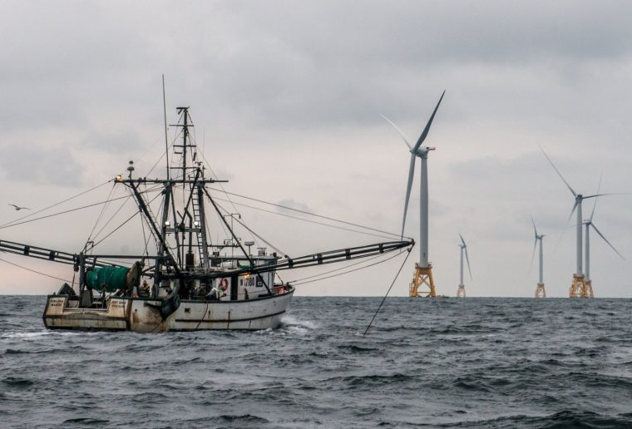
Challenges for Offshore Wind
Cost
Protection of North Atlantic Right Whales
Transmission interconnection
Coexisting with the fishing industry

Slide 8
Opportunities for Offshore Wind
Huge resource, close to load
Reduced Costs in Europe
New industry, local jobs
Meet demand of regional generation retirements
Diversify fuel mix
Address climate change

Slide 9
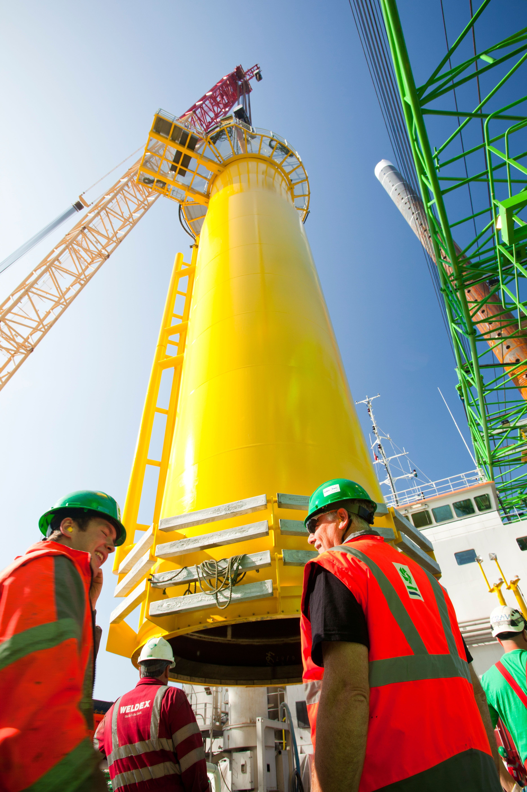
MassCEC’s Role in Offshore Wind
MassCEC works to accelerate offshore wind by addressing market barriers:
Stakeholder Engagement
Fisheries Working Group
Environmental Characterization
Infrastructure
Port & Infrastructure Assessment
Workforce Development
Supply Chain & Match-Making

Slide 10
Next Steps
Second Massachusetts solicitation NLT June 2019, required to be lower cost
BOEM released a Proposed Sale Notice for the two MA unleased in April 2018. Schedule for auction in Fall 2018 – could create more competition for second solicitation
Developers in MAWEA and RI/MA wind energy areas are able to compete in New York, Connecticut, Rhode Island solicitations

